Slide 1

Using AI Chatbots to Recommend Restaurants

Slide 2
Presentation Agenda
Our Team
The Problem to Solve
Our Solution
Business Value
Conclusion

Slide 3
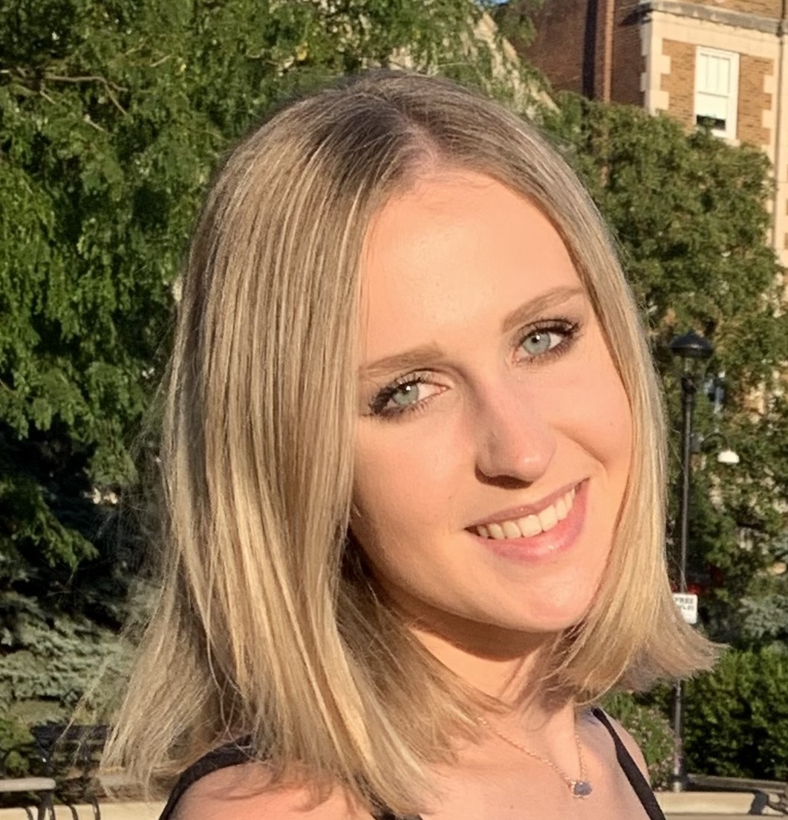
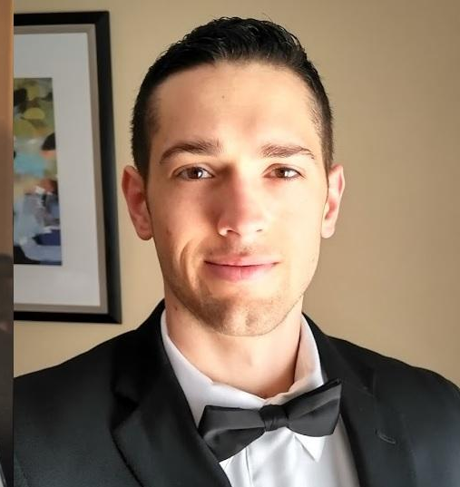

Meet the Team!
Magda Odrowaz
Buffalo Grove, IL
B.S. Kinesiology & Health ‘22
M.S. Business Analytics ‘23
Adam Brobson
Jenks, OK
B.S. Mechanical Engineering
M.S. Business Analytics ‘24
Evan Frank
Bainbridge, OH
B.S. Physics ‘21
M.S. Business Analytics ‘23

Slide 4
Pain Point
Ever ask your significant other or friends where to go to eat and they say “wherever”? This leads to the never ending conversation loop of “I don’t care, where do you want to eat”?

Slide 5
Well No Longer!

Slide 6
Our Project Idea and Solution
We will gather information about local restaurants: reviews, type of restaurant, and price range. We will then use this data to train our models to predict where you should eat! Leveraging an AI chatbot in a website setting to interface with a recommendation engine (ALS, K nearest neighbors, etc.) We will give struggling friends and couples an easy way to get restaurant recommendations!
Notes:
Presentation Template: SlidesMania
Images: Unsplash
Please keep this slide or mention us and the other resources used in the footer of a slide.

Slide 7
Business Value
We as a business need to be able to monetize our website and there are two easy ways to do so!
Standard Website ads, either banners or side panel ads.
Selling preferential placement in our recommendations to restaurants (with an ad marker) similar to how google ads work.

Slide 8
Conclusion
By leveraging AI chatbots and recommendation engines we can help solve the issue of “where do you want to eat?”
This can then be used to create customized restaurant recommendations to save you and your friends time and money!
We will drive our own revenue through ad placements and preferential placements of restaurants.

Slide 9
Questions? Email Us!
Evan Frank: frankec@miamioh.edu
Magda Odrowaz: odrowamm@miamioh.edu
Adam Brobson: brobsoaw@miamioh.edu

